Slide 1


BEDTIME STORY INFORMATION EVENING
26th February 2024
Notes:
Housekeeping – toilets / fire bell
Any packs to go home?
Thank everyone for coming – especially when date changed – and thank staff.

Slide 2
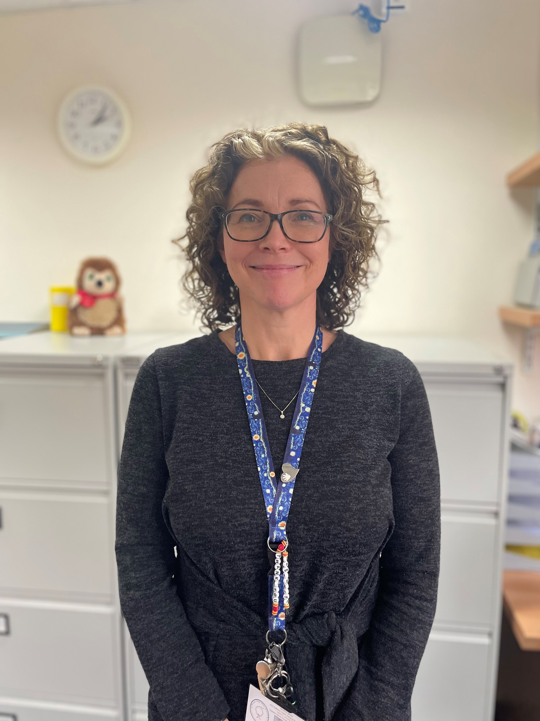

MRS HUME
Mrs White
Mental Health and ASD Inclusion Support Practitioner
Headteacher and Interim SENCo
Notes:
Welcome and introduce other staff.

Slide 3
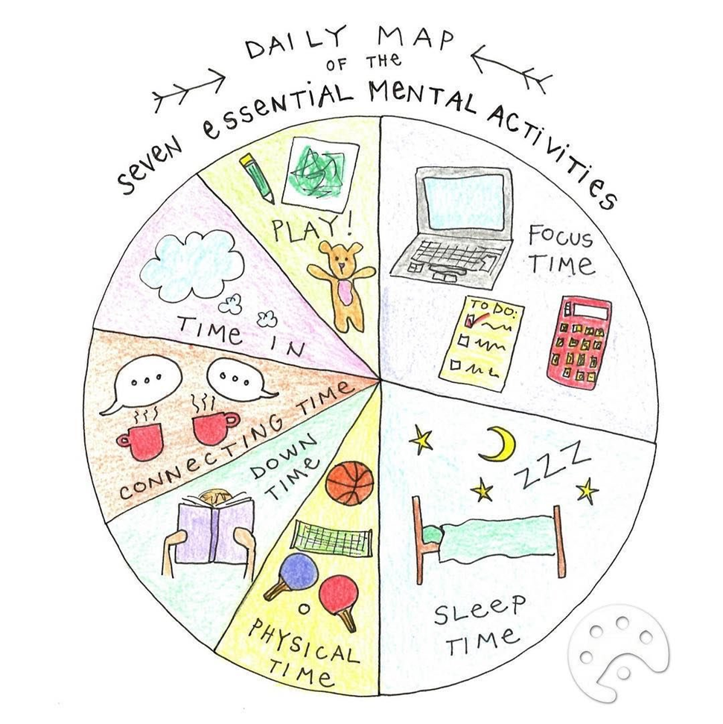
What is Wellbeing?
‘Learning and Growing Together’
‘Childhood wellbeing is multi-dimensional and should include dimensions of physical, emotional and social wellbeing; it should focus on the immediate lives of children but also consider their future lives.’
Childhood Wellbeing: A Brief Overview, Gov.uk
Notes:
Our purpose at Damson Wood is to enable the children here to learn and grow together.
The learning and growth our children experience at Damson Wood lays a strong and well-grounded foundation for children to continue to progress in the future.
Our teachers and support staff also value the ethos of learning and growing together. They are reflective practitioners and take a highly proactive approach towards their own professional development. Staff are supported to look after their own well-being and take good care of each other. They recognise the efforts and progress of children and their colleagues and, together, have the drive and determination to create the best school for children and adults to thrive in.
We commit ourselves fully to ‘Learning and Growing Together’ at Damson Wood and this aspiration, underpinned by our core SPARKS values, drives all we do.

Slide 4
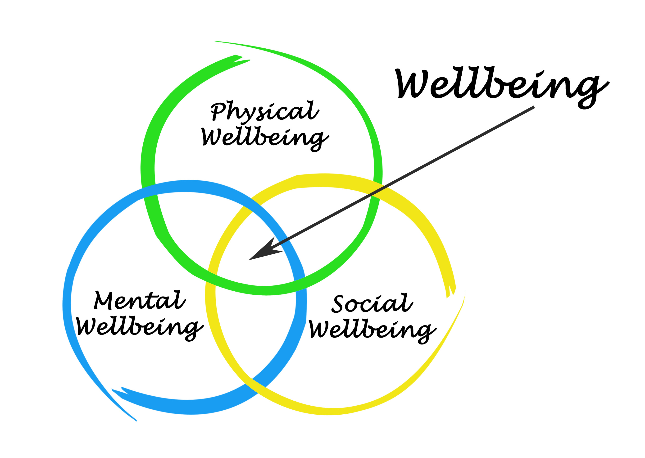
What is wellbeing?

Slide 5

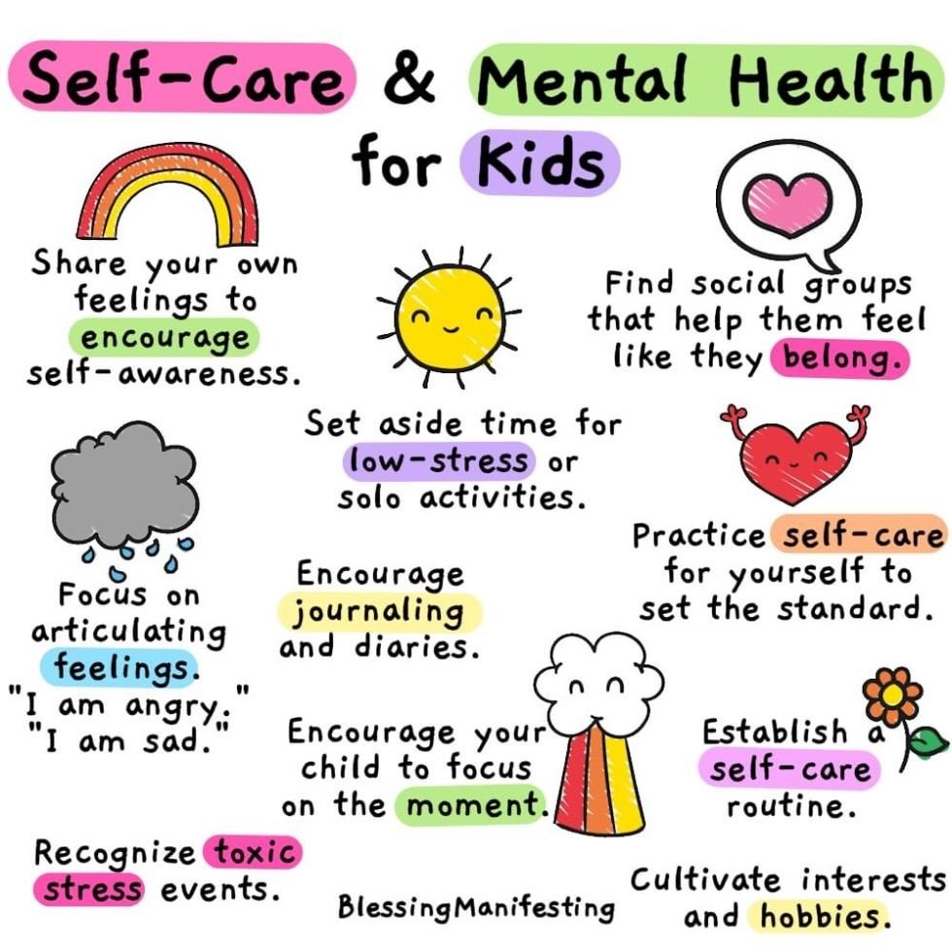
Wellbeing
Physical Wellbeing
  Sleep
Social Wellbeing
  Attendance
  Staying Safe
Mental Wellbeing
  Emotions
  Learning
Parent Wellbeing
Notes:
Share curriculum – subjects taught discretely and through project where fits. Children progress through our curriculum – progressive and sequential. Focuses on key learning outlined in the national curriculum.
Project Planners / Knowledge Organisers
Different names for some subjects in EYFS but all subjects covered.
One of our priorities is to measure impact of foundation subjects and to ensure that we meet needs of all children to help them to make progress.
Hand over to Emily to share SEND.

Slide 6
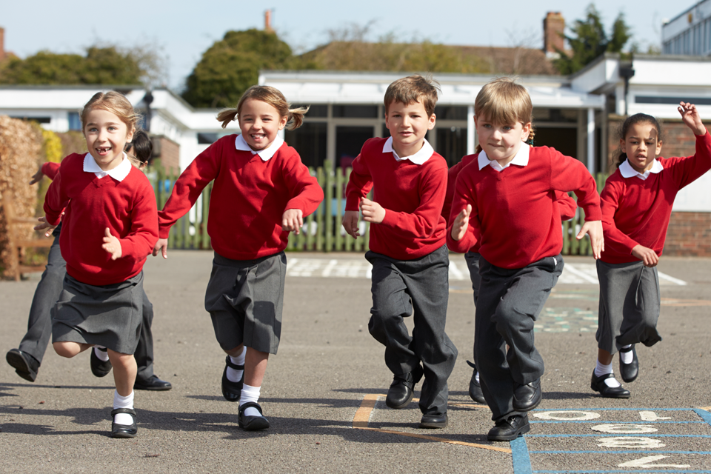
Physical Well-being
If children have the right physical foundations in place (eating, well sleeping well, exercising regularly), this will help contribute to positive mental health.

Slide 7
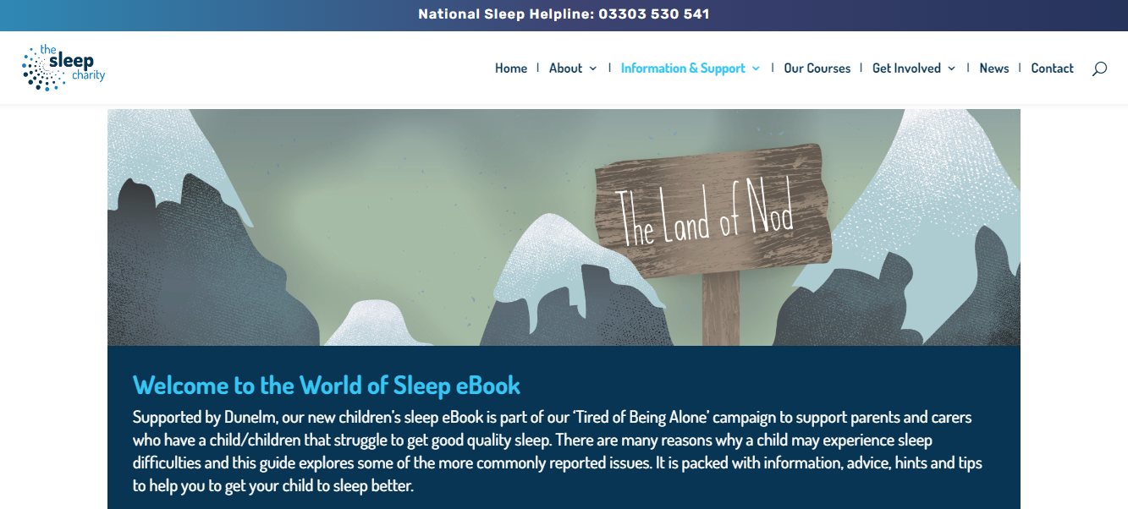
SLEEP
https://thesleepcharity.org.uk/information-support/children/
Notes:
Our purpose at Damson Wood is to enable the children here to learn and grow together.
The learning and growth our children experience at Damson Wood lays a strong and well-grounded foundation for children to continue to progress in the future.
Our teachers and support staff also value the ethos of learning and growing together. They are reflective practitioners and take a highly proactive approach towards their own professional development. Staff are supported to look after their own well-being and take good care of each other. They recognise the efforts and progress of children and their colleagues and, together, have the drive and determination to create the best school for children and adults to thrive in.
We commit ourselves fully to ‘Learning and Growing Together’ at Damson Wood and this aspiration, underpinned by our core SPARKS values, drives all we do.

Slide 8
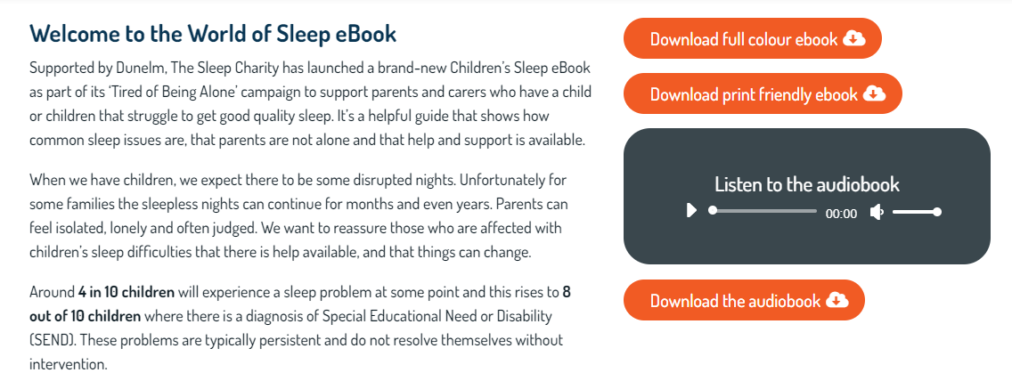
The sleep Charity

Slide 9
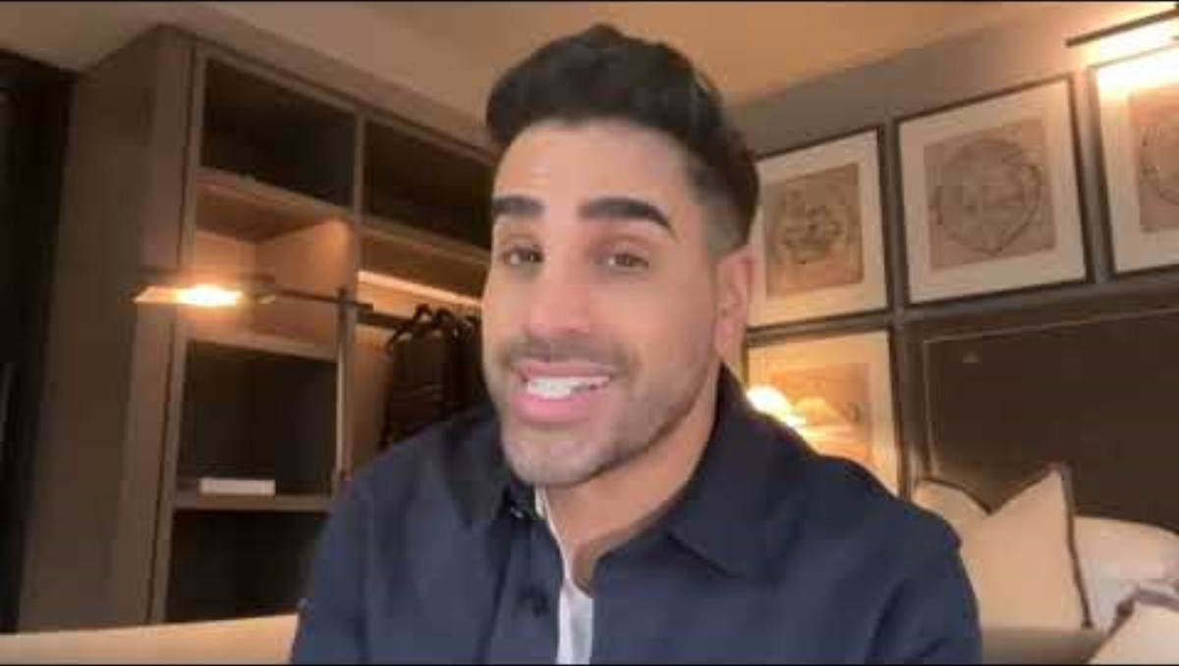

Slide 10
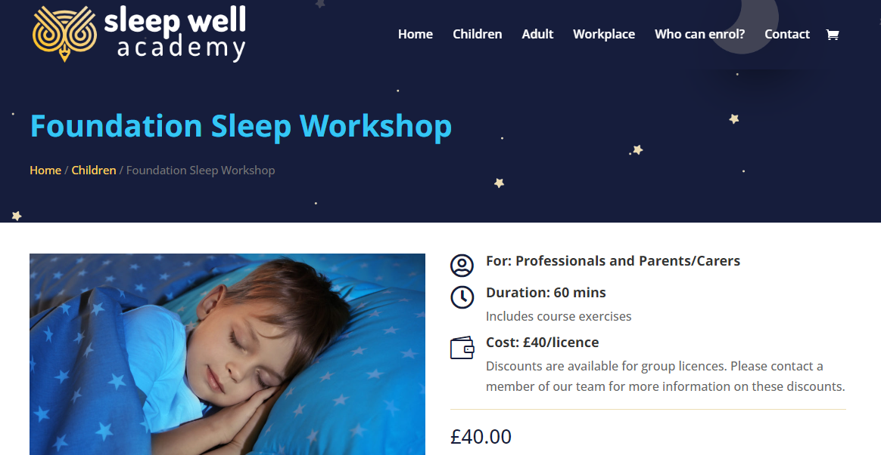
Sleep Workshops
https://thesleepcharity.org.uk/our-courses/

Slide 11
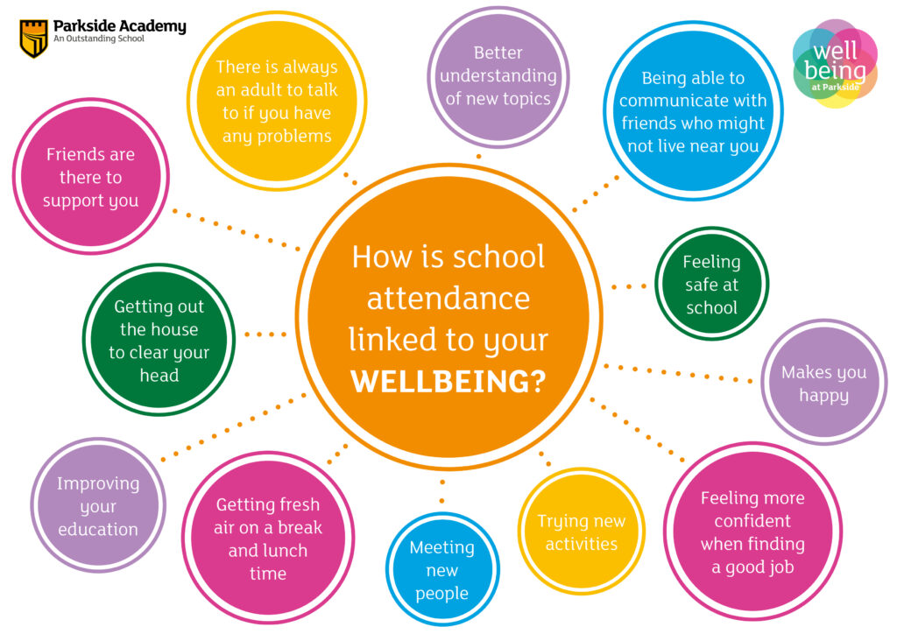
Social Wellbeing
Attendance Matters!
Not just about academic progress but also supports children's wellbeing through friendships, play and communication.
Children miss out on far more than just learning when then are absent from school.

Slide 12

Staying Safe
Safeguarding Culture
Children knowing who to turn to if they feel unsafe or uncomfortable about something.
Can be difficult to know how to answer questions or offer support, espcially as children grow up and issues become more challenging and complex.
Lots of resources online to support parents/carers.

Slide 13

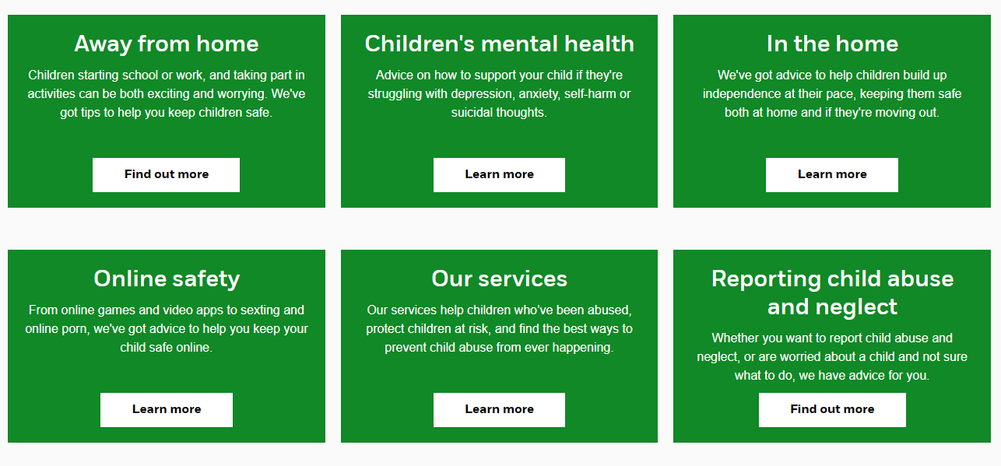

STAYING SAFE​
https://www.nspcc.org.uk/keeping-children-safe/

Slide 14
STAYING SAFE
Important to address issues in an age appropriate and safe way.
Aim to develop healthy, safe relationships from a young age.
With younger children, the aim is to develop respectful attitudes by focusing on learning that supports inclusion and belonging rather than covering specific types of discrimination, such as misogyny.
At key stage 1 this might include exploring how everyone deserves to be treated with respect. Also, recognising and celebrating our differences and similarities.
This will all help to prepare pupils for more specific learning about discrimination later, especially as they access digital platforms with increasing independence.

Slide 15
Safe Online Relationships
Online Safety - understand that people sometimes behave differently online, including by pretending to be someone they are not.
Online Respect - that the same principles apply to online relationships as to face-to face relationships, including the importance of respect for others online, particularly when we are anonymous.
Online Friendships - how to critically consider their online friendships and sources of information including awareness of the risks associated with people they have never met
Being safe - how to report concerns or abuse, and the vocabulary and confidence needed to do so.

Slide 16

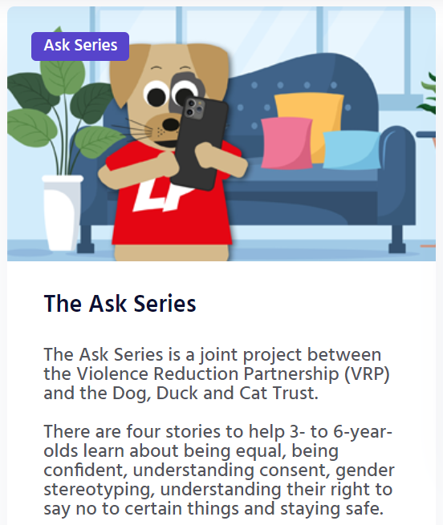


Slide 17




STAYING SAFE
Access the stories online
Read through the interactive stories
Make sure you use the useful tips to ask questions
We recommend reading both stories yourself to determine which is most appropriate for your child/children’s level of understanding and maturity.
https://www.dogduckandcat.co.uk/parent-carer-guardian
Notes:
Log in with name etc

Slide 18
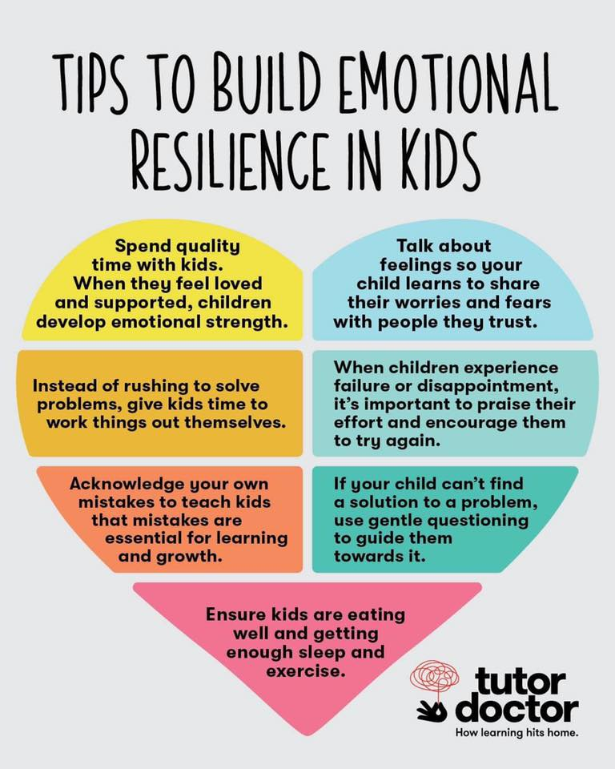
MENTAL Wellbeing
It is essential that we support our children's mental wellbeing to help them to have healthy relationships, be able to manage big emotions and navigate social situations both in real life and (in the future) online.

Slide 19
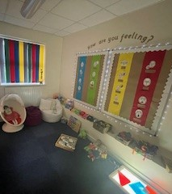
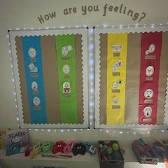
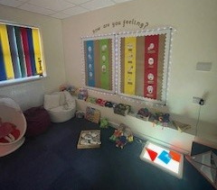
MENTAL Wellbeing

Slide 20


EMOTIONS

Slide 21


Slide 22
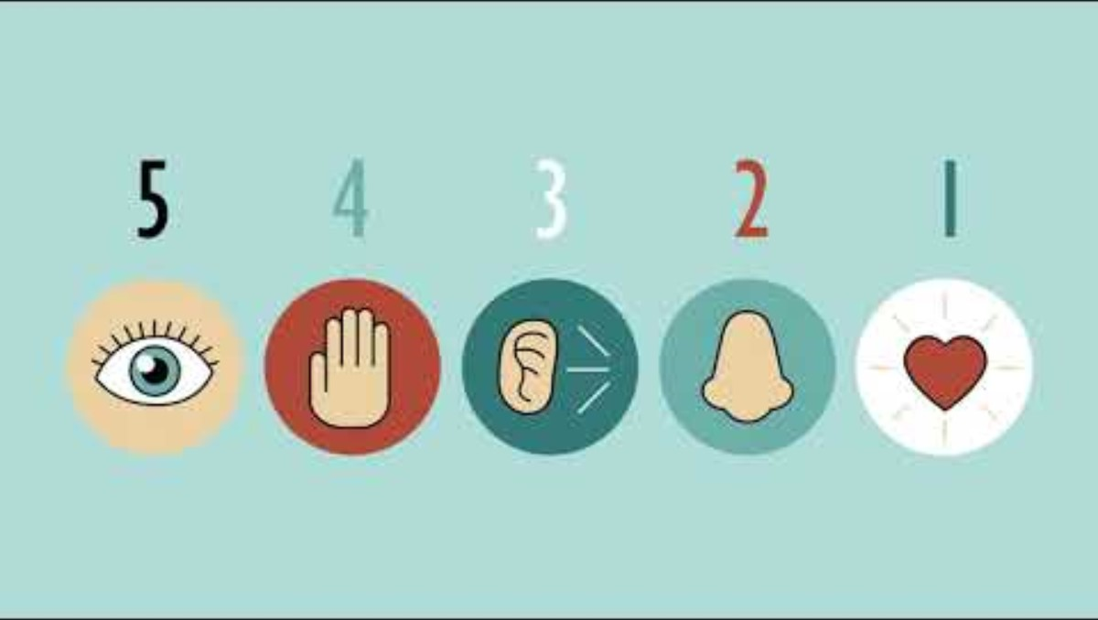

Slide 23

CHANGES?

Slide 24

MENTAL HEALTH CONCERNS
https://www.youngminds.org.uk/parent/

Slide 25

LEARNING – 5 Ways to Wellbeing

Slide 26

Learning - reading

Slide 27
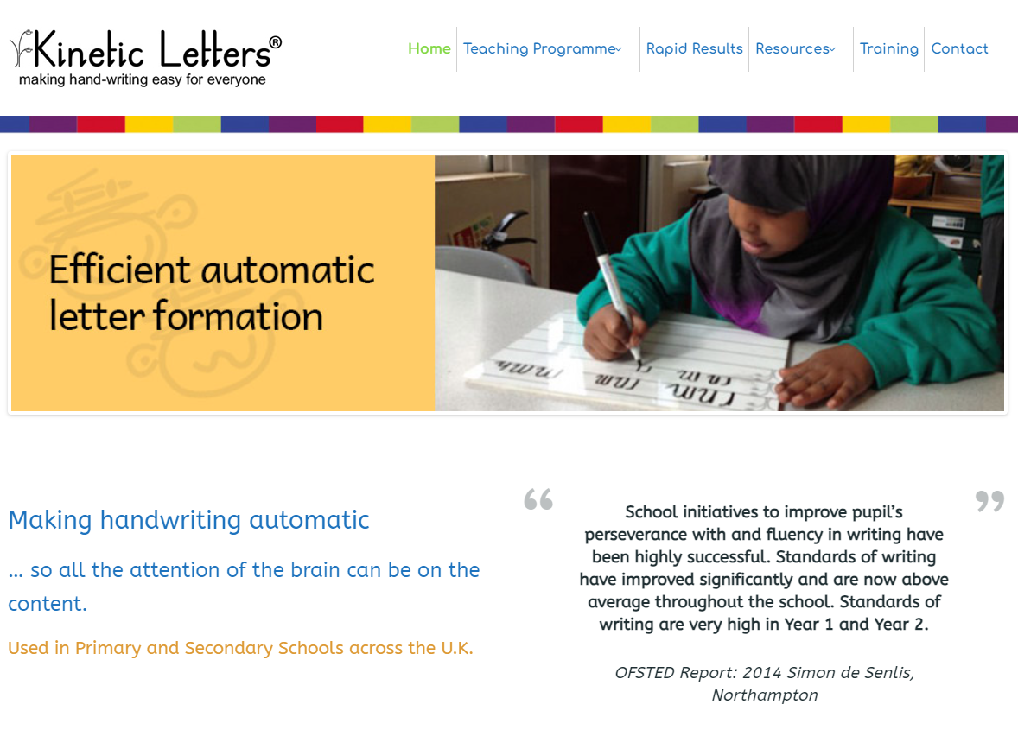
Learning – KINETIC LETTERS

Slide 28
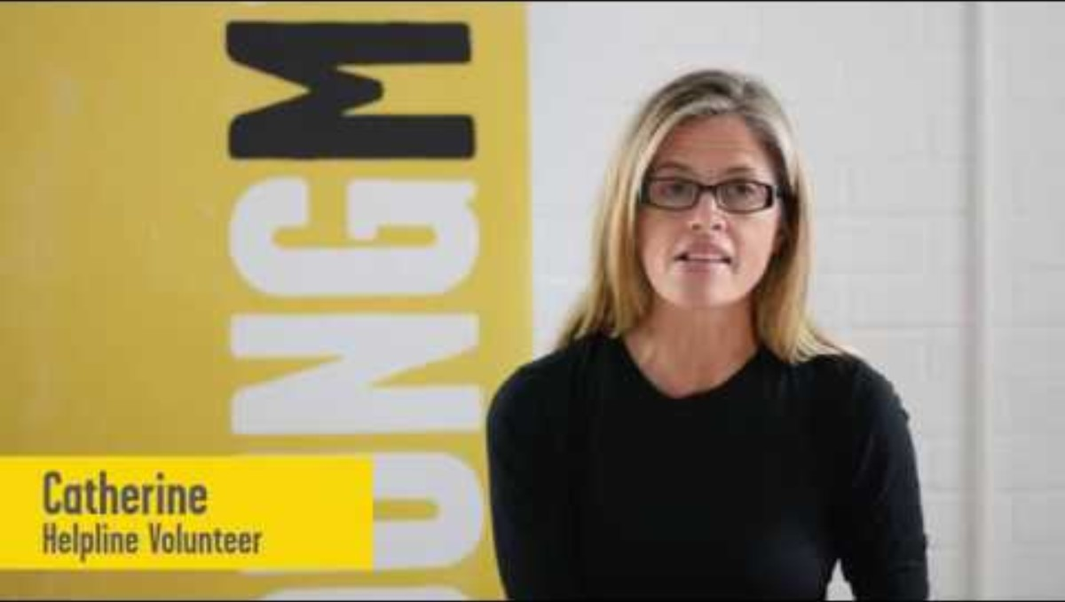
PARENT / CARER WELLBEING

Slide 29
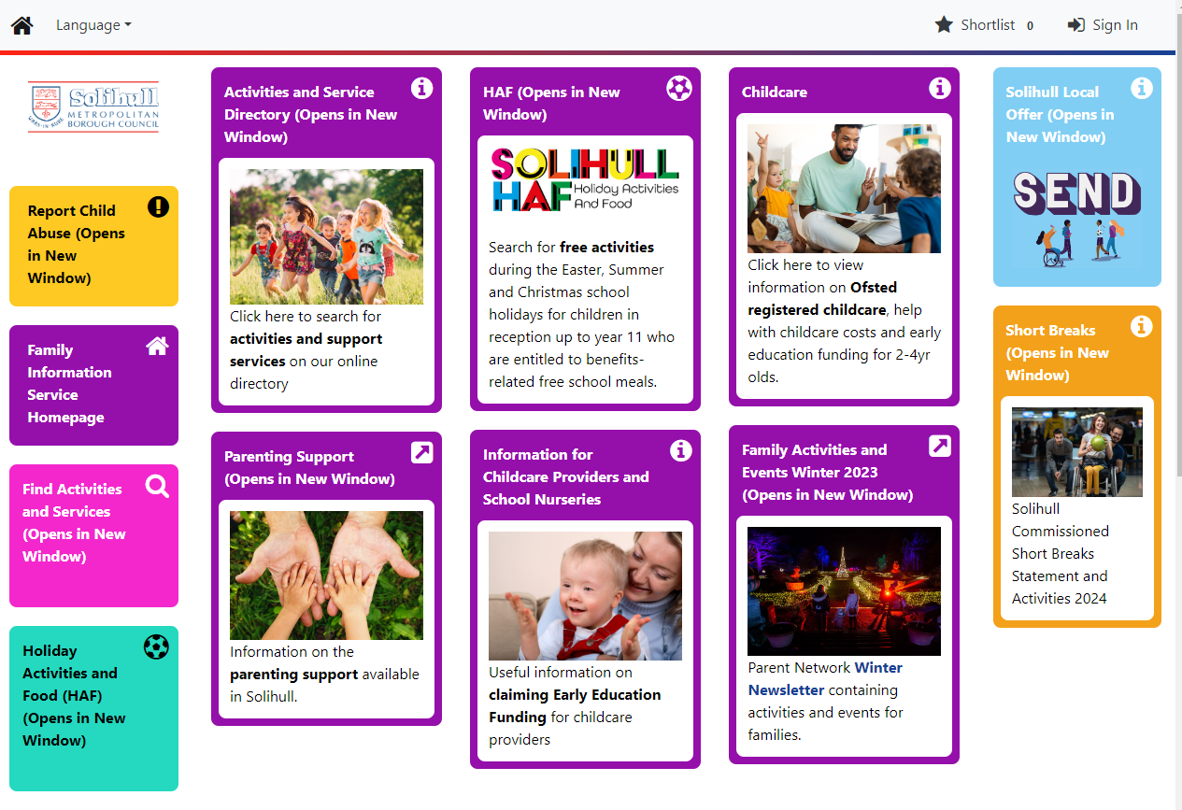
https://edportals.solihull.gov.uk/Synergy/Live/SynergyWeb/Solihull_Childcare/

Slide 30
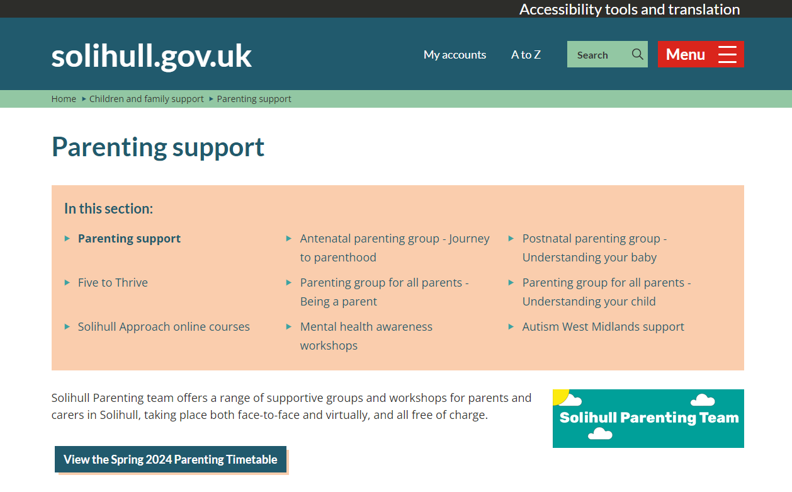
https://www.solihull.gov.uk/children-and-family-support/parenting-support

Slide 31
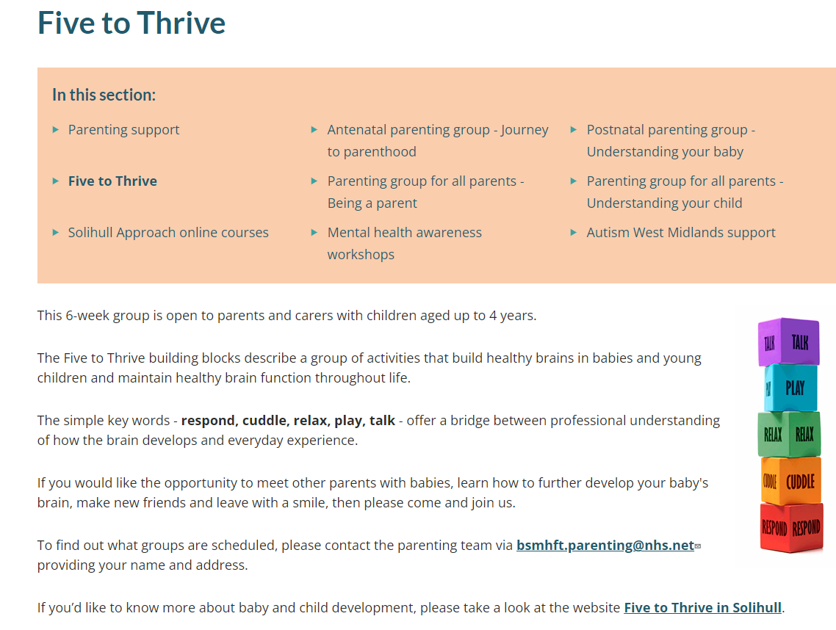
https://www.solgrid.org.uk/fivetothrive/

Slide 32
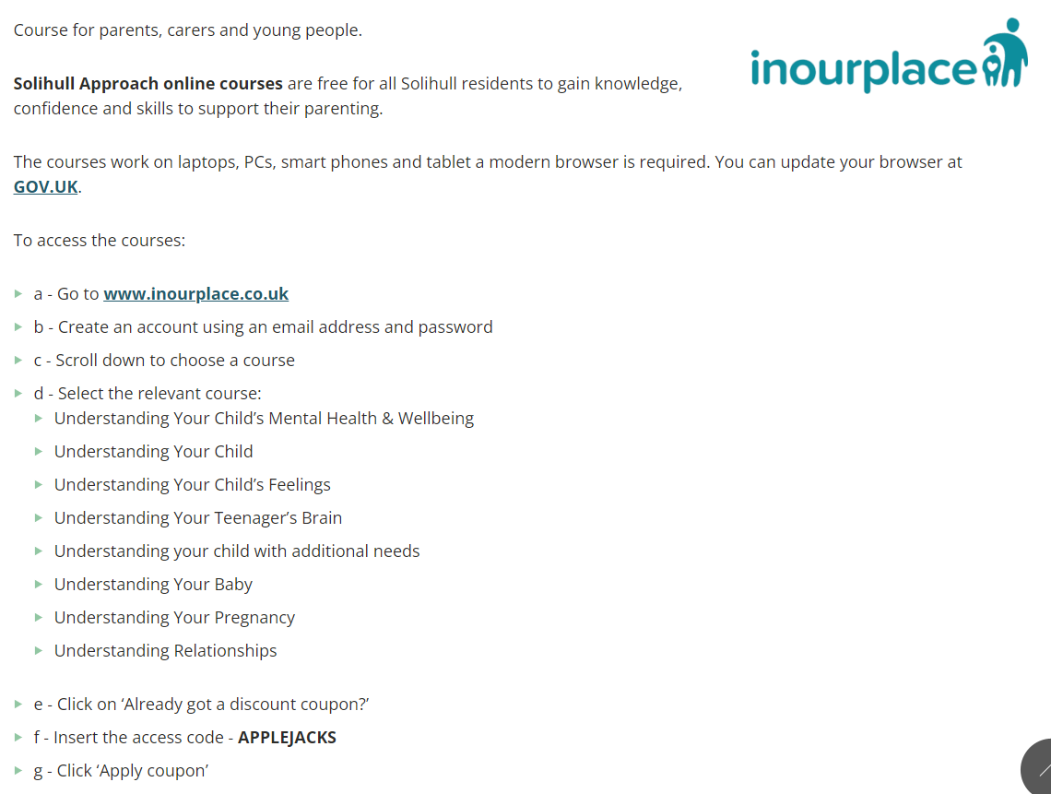
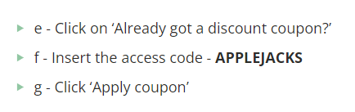
https://www.solihull.gov.uk/children-and-family-support/parenting-support/online-courses

Slide 33
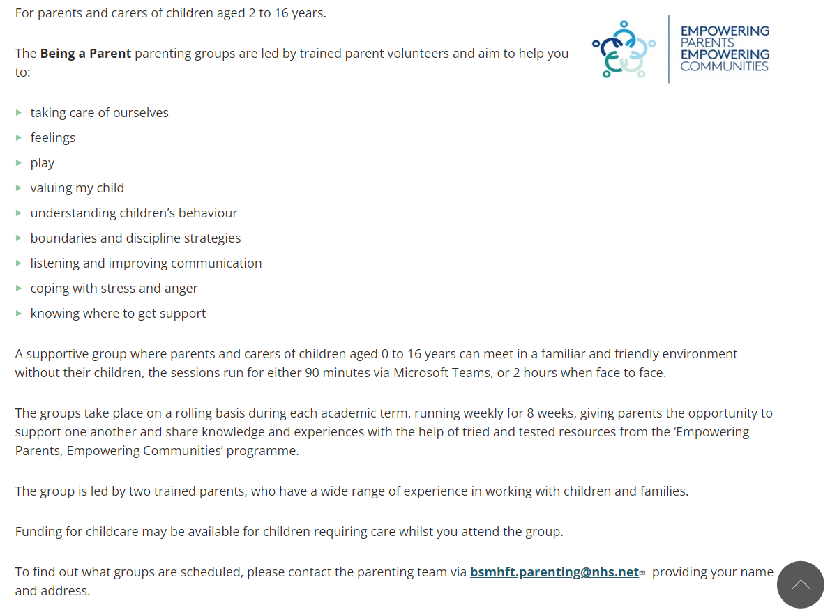
https://www.solihull.gov.uk/children-and-family-support/parenting-support/being-a-parent

Slide 34


Slide 35
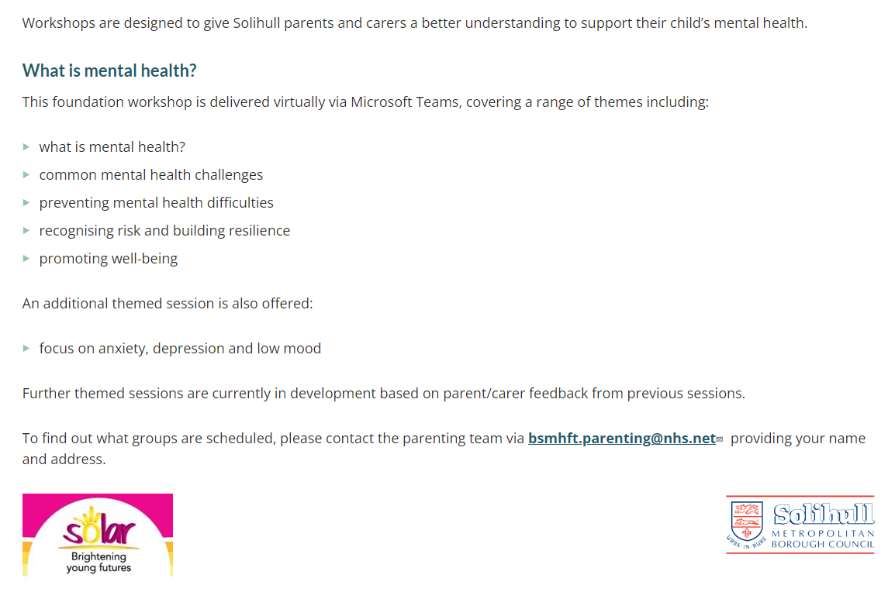
https://www.solihull.gov.uk/Children-and-family-support/parenting-support/mental-health-awareness-workshops

Slide 36
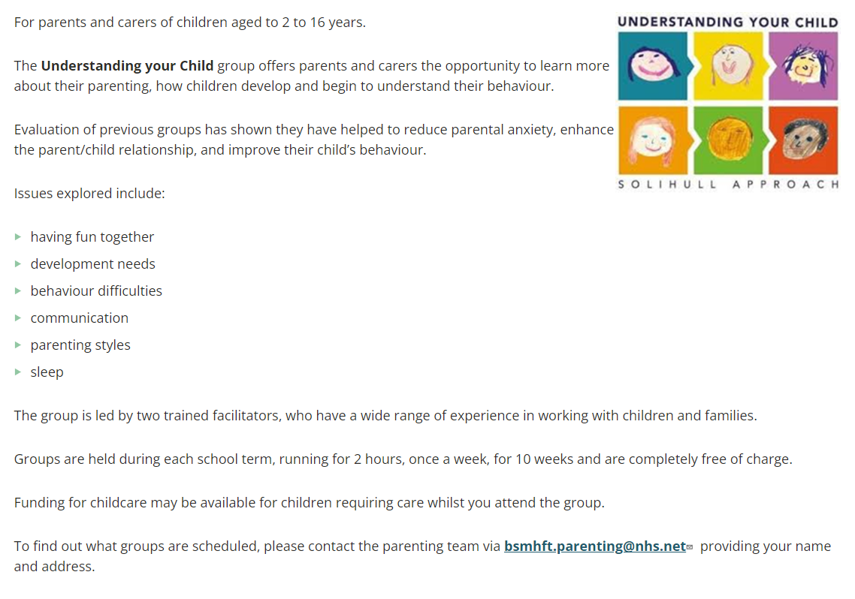
https://www.solihull.gov.uk/children-and-family-support/parenting-support/understanding-your-child

Slide 37
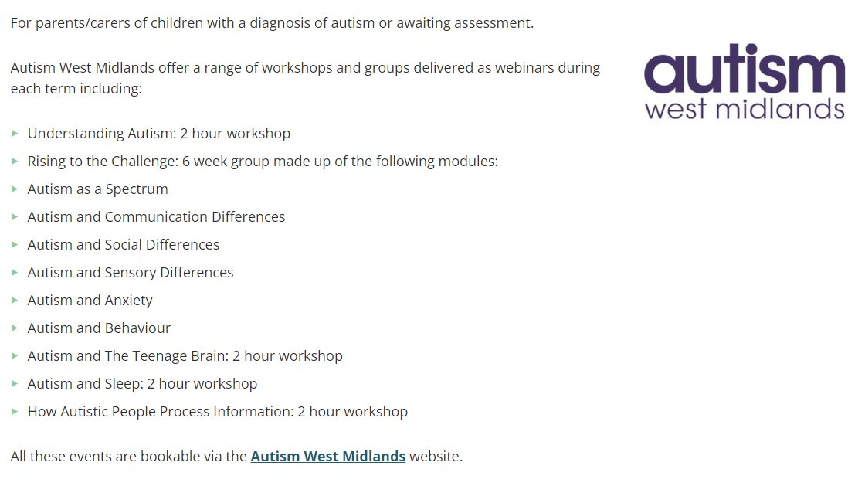
https://www.solihull.gov.uk/Children-and-family-support/parenting-support/autism-west-midlands-support

Slide 38
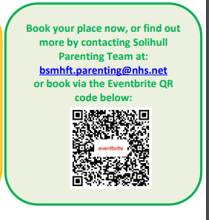
bsmhft.parenting@nhs.net

Slide 39

We are also always here to offer support and advice. Feel free to contact your child's class teacher, Mrs Hume or Mrs White via the school office: 0121 705 8652 or office@damson-wood.solihull.sch.uk
Notes:
Thank you for watching – questions to office

