Slide 1

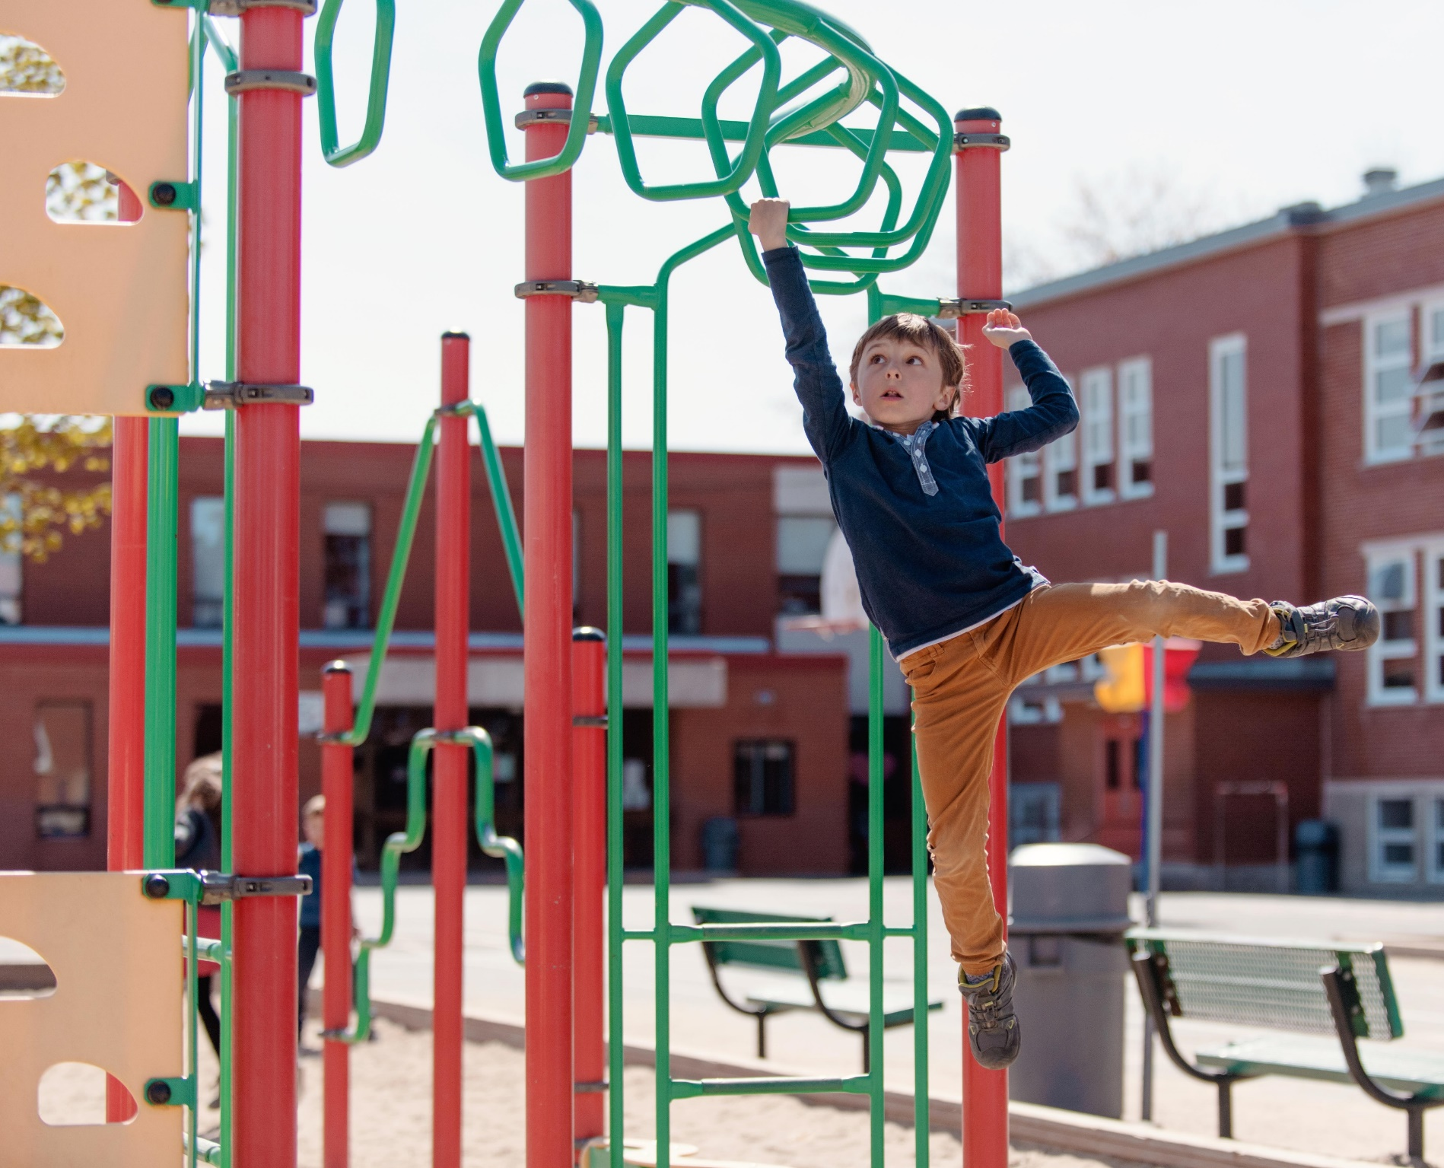
Attendance and Early Years
Help your child succeed build the habit of good attendance

Slide 2

Why is attendance in Nursery and Reception Important ?
To help children enjoy learning and achieve the best they can
There is a strong link between attendance and how well children do at school
To make friends and learn from others
To help children feel they belong
To get into good habits for later life

Slide 3

What is Good Attendance ?
Attending everyday the school is open and on time
Average attendance for primary schools in England is around 96%
Attending week after week without any time of

Slide 4
Good school attendance will help your child to:
Develop their knowledge of school routines and expectations meaning they will feel comfortable and secure in a new environment.
Develop social skills and friendship groups.
Develop positive relationships with staff and children.
Take part in all aspects of the Curriculum
Not miss out on exciting new experiences.

Slide 5
What is Poor Attendance ?
Children who are in and out of school for minor reasons
Children who do not complete full weeks at school
Children who arrive late for school

Slide 6
Being absent from Nursery or Reception can:
Make it harder to develop early reading skills
Make it harder to build positive relationships with staff and other pupils
Develop a poor attendance pattern that is hard to break

Slide 7
The routines your child develops in Nursery and Reception continue throughout school. You can make the most of Early Years by encouraging your child to attend every day.

Slide 8

What can you do
Set a regular bedtime and morning routine – allowing time for things to go wrong as they sometimes do with small children.
Making sure your child leaves for school early enough to arrive at school on time.
Develop back-up plans for getting to nursery or school if something comes up (eg you are not well)
Support and encourage your child by attending parents' evenings and other events.
Contact the school to discuss any concerns regarding your child’s attendance.
Work in partnership with the school to resolve any issues that are impacting on their child’s attendance.
Make any medical appointments outside of school hours whenever possible.
Not take children out of school for holidays in term time or for other unnecessary reasons.
Ensure School is notified by telephone if your child is absent, on the first day of absence and they are kept updated throughout any absence period.

Slide 9
What school will do
Create a welcoming, stimulating and safe learning environment
Make early contact with parents when a pupil fails to attend school without providing good reason
Regular monitoring attendance and contact with parents where concerns arise about attendance and agreed interventions or support.
Offer follow up support if needed.
Meet Regularly with schools CSAWS Attendance and Welfare Officer to review pupil attendance.

